Slide 1
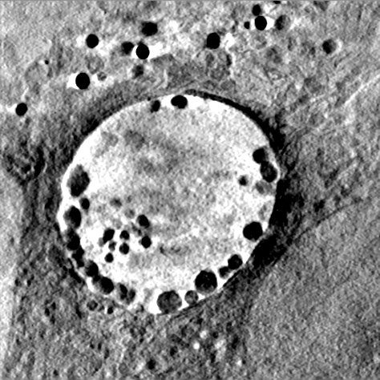
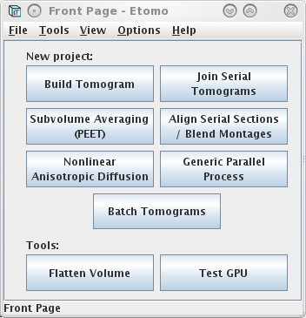
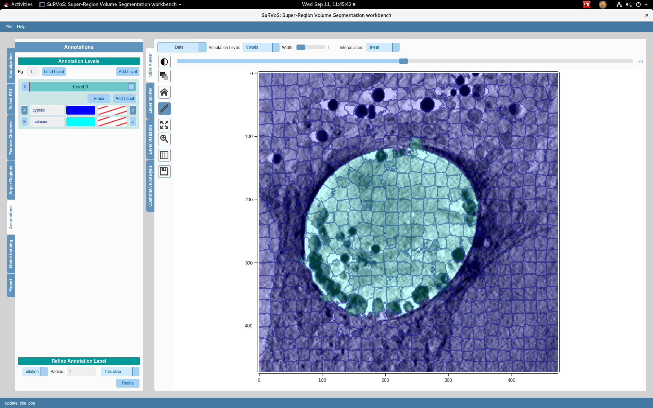
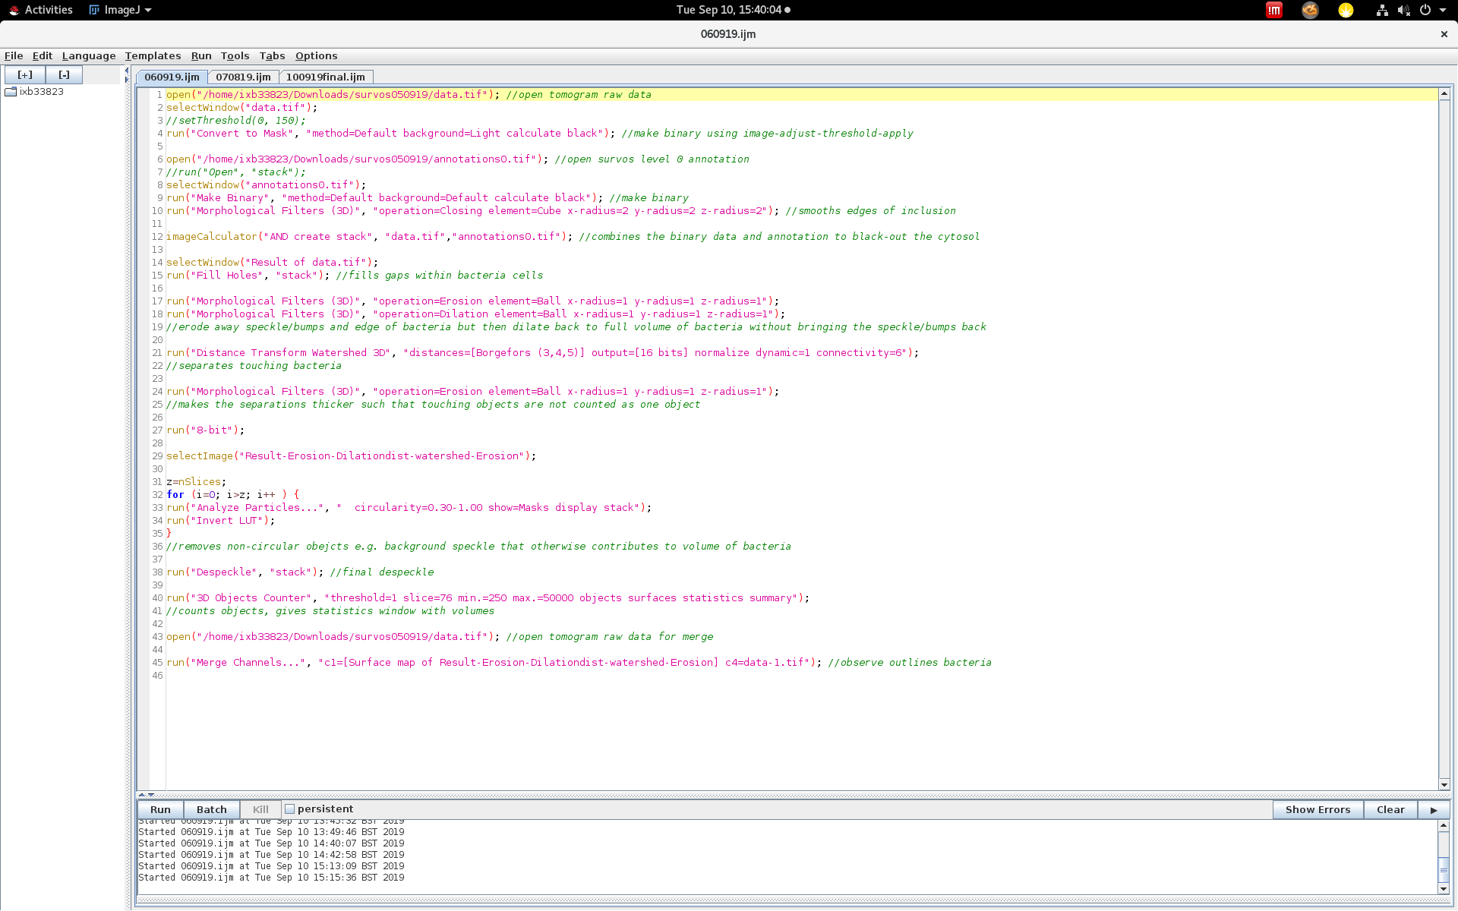
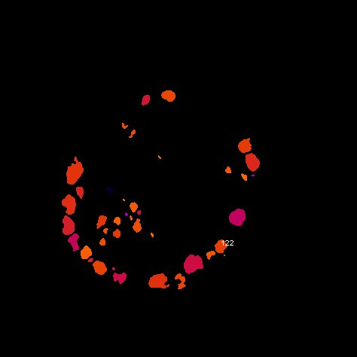
Pipeline for segmentation of tomograms
Patrick Phillips

Slide 2
IMOD - Reconstructing the Tomogram
First may need to open the .tif in Fiji, adjust b&c (slide min all the way to left and max all the way to right), make 16 bit, adjust b&c (again min min and max max), then save and convert this to a .st file)
Module load imod/4.9
etomo
Tif2mrc
Convert raw .tif file into a .st file
Use command: tif2mrc ‘file name’.tif ‘file name’.st
Reconstruct Tomogram in ETomo
Tutorial: https://bio3d.colorado.edu/imod/doc/etomoTutorial.html
Use B24 parameters (on IMOD for B24 powerpoint)
Or use patch tracking
Nonlinear Anisotropic Diffusion in ETomo
Tutorial: https://bio3d.colorado.edu/imod/doc/NADexample.html
Rename to .nad.rec as can only open .rec in SuRVos

Slide 3
2. SuRVoS
The ‘labels’ within level 0 (cytosol and inclusion) need to always be the same order when making the annotation for each tomogram (always cytosol on top inclusion on bottom)
Tutorial: https://diamondlightsource.github.io/SuRVoS/
module load global/cluster
qlogin -q high.q -P b24 -l gpu=2 -l gpu_arch=Pascal
module load survos/2019
survos
Filter and set voxels that best separate the inclusion and cytosol
Annotate the inclusion and the cytosol as ‘level 0’ throughout the stack
Clean edges is most important, can do some manual annotations at voxel level
Use the model training to annotate through slices
Check that the inclusion is clearly excluded throughout the stack
Export level 0 raw annotation as a tiff
Export raw data as a tiff

Slide 4
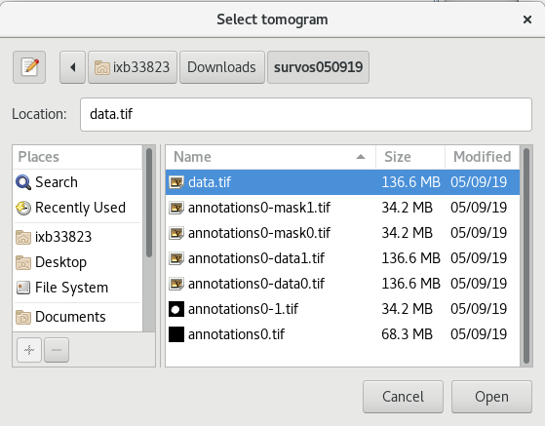
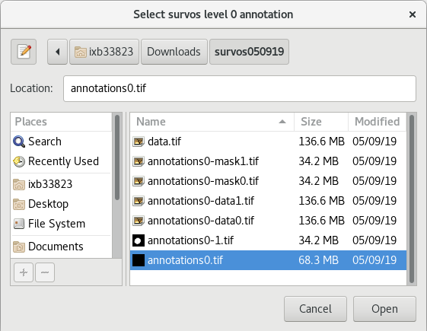
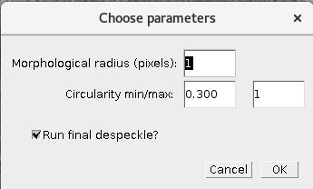
3. Fiji Macro
module load imagej/2019
fiji
Plugins-macros-run
Select macro for segmentation of tomograms (.ijm), instructions in green, Run
Window opens to select tomogram file, choose parameters and select SuRVoS annotation
Choose the raw data and annotation .tif files exported from SuRVoS

Slide 5
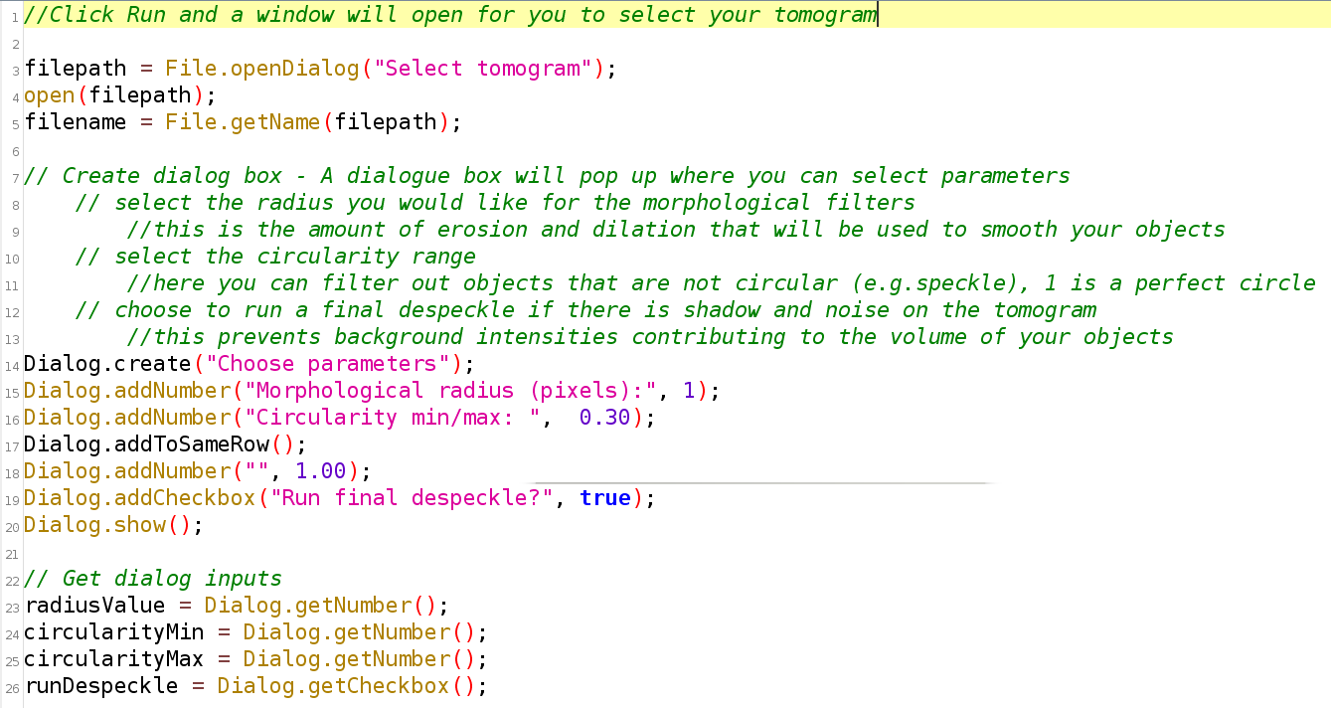
3.1 Start of macro with instructions in green

Slide 6
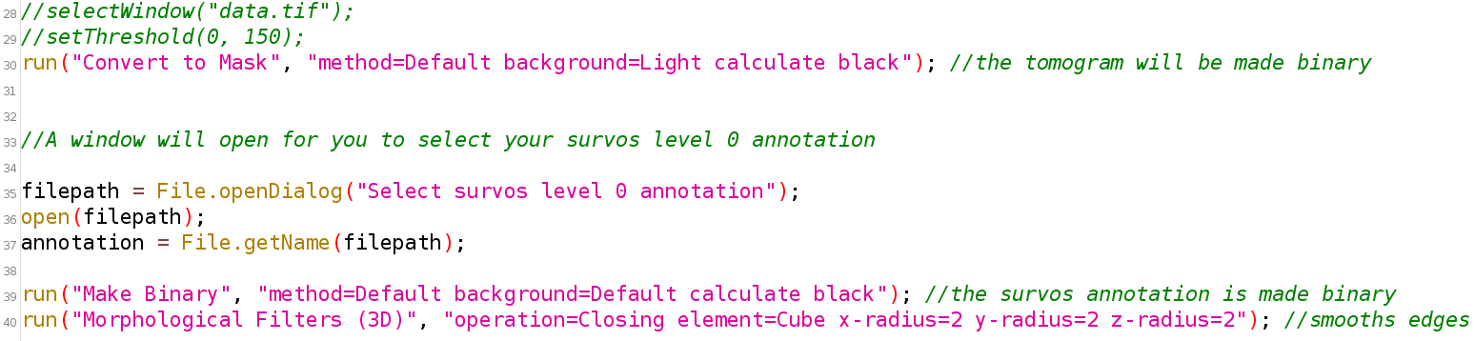
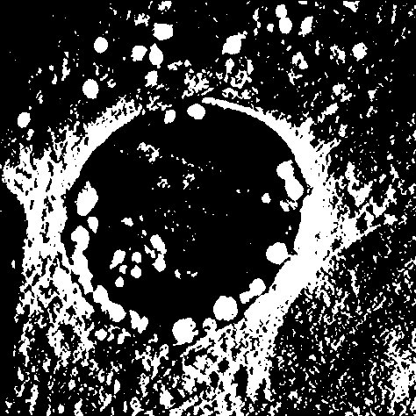
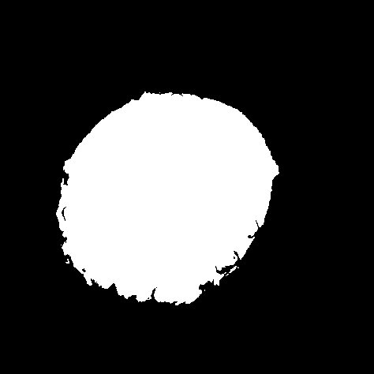

3.2 Convert files to binary
Threshold the tomogram
Make SuRVoS annotation binary and fill gaps

Slide 7
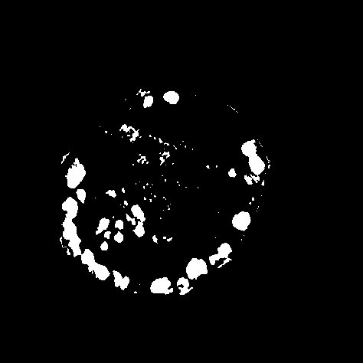
3.3 Combine binary files
Gaps within bacteria filled

Slide 8

3.4 Filter
Fill holes within bacteria, erode away speckle then dilate bacteria back to original volume

Slide 9
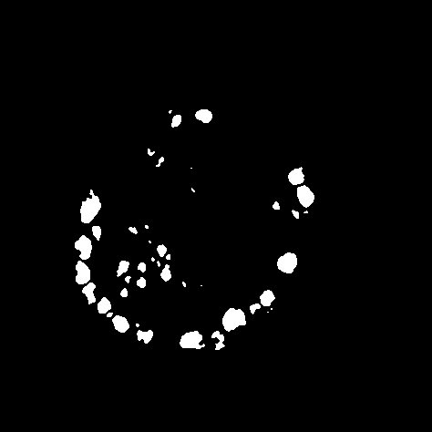
3.5 Watershed and filter
Separate touching objects, erode to make separations thicker for the 3d Objects Counter command

Slide 10
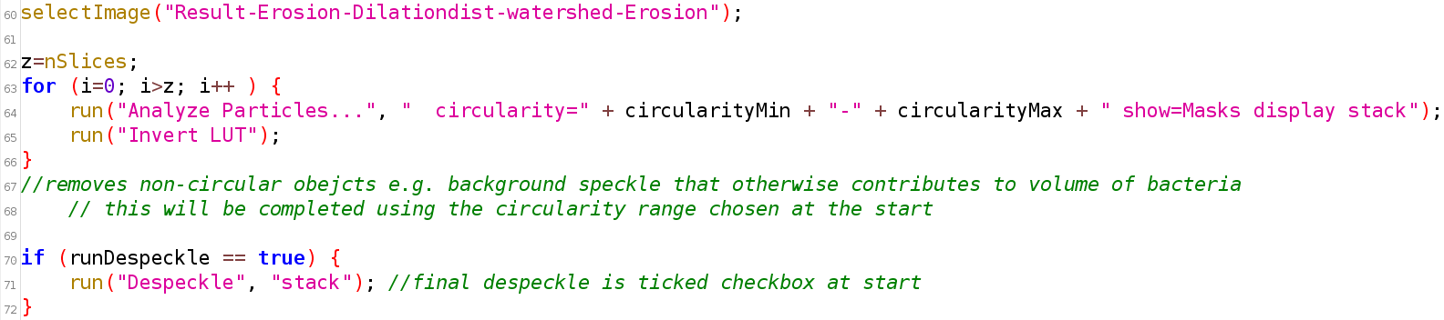
3.6 Despeckle
Filter by circularity to remove speckle that otherwise contributes to volume of bacteria
Final despeckle command if selected at start

Slide 11
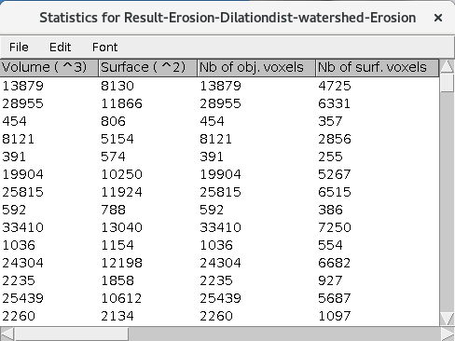
3.7 Count objects
Employs a size filter to discount speckle and objects touching the ends
Gives objects map (below) and surface map (outlines) with each object counted (white number)
Gives statistics table in order of count

Slide 12
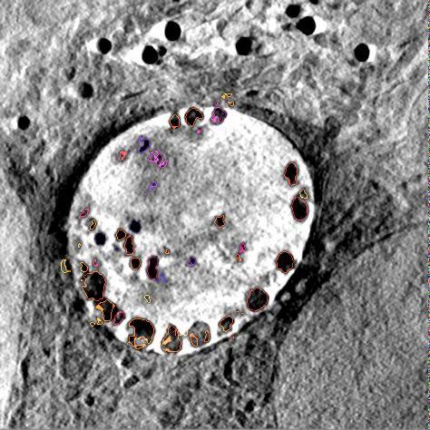
3.8 Merge
Observe the composite of the surface map and original data with each object outlined and counted
Use to discount and objects that are not bacteria on the original data

Slide 13
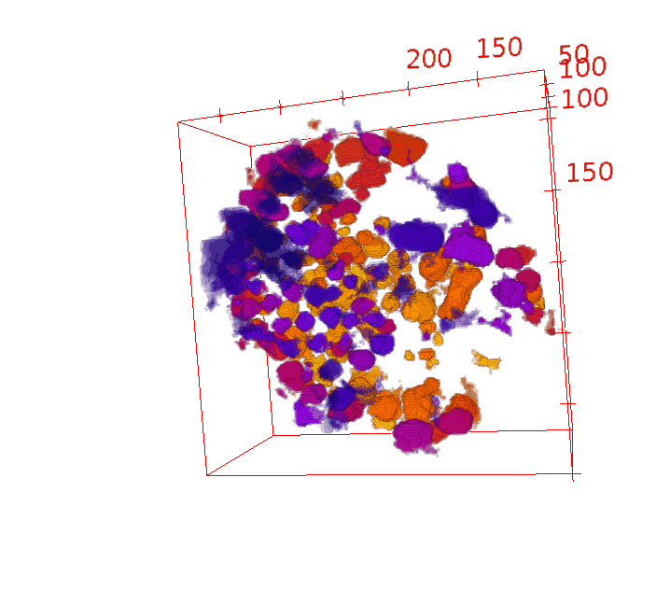
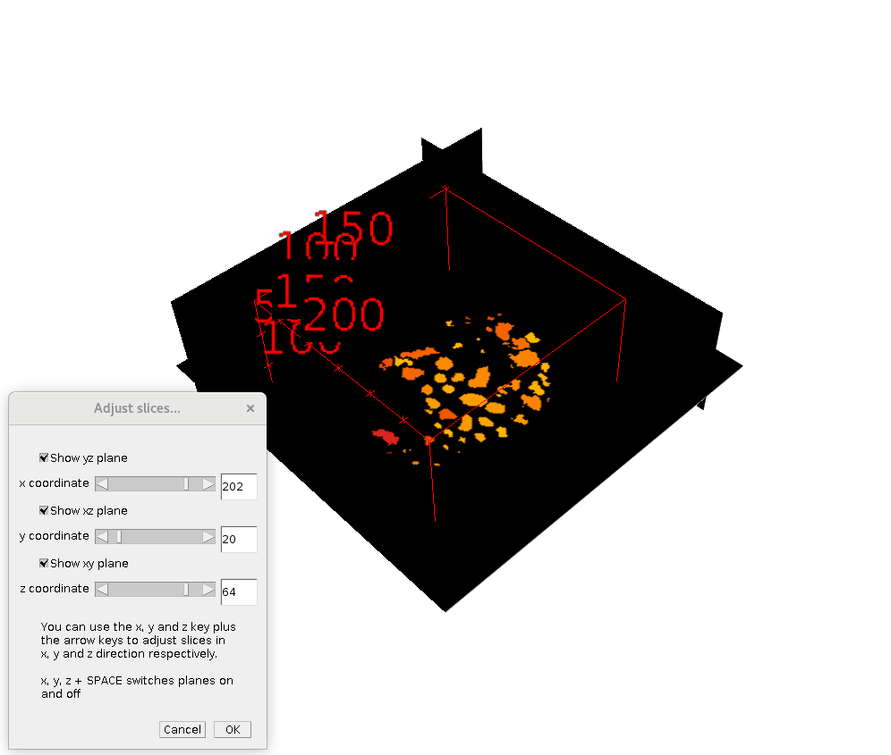
3.9 3D Viewer
Plugins-3D Viewer
Check if objects are joined
Edit-Display as-Orthoslice
Right click, adjust slices, scroll through to find 3D coordinates of objects
Top slice
Bottom slice

Slide 14
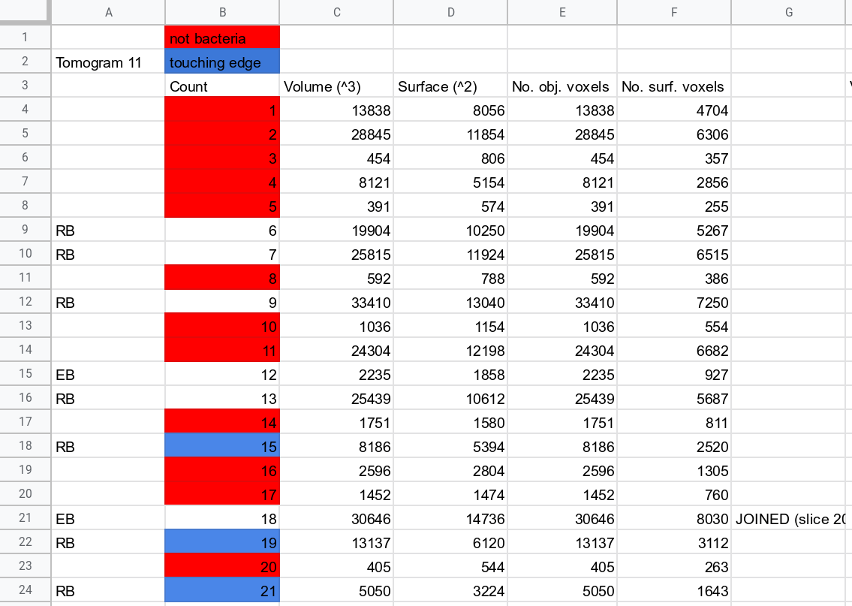
4. Statistics
Curate the data, scroll through merge/ 3D View to exclude any objects you don’t want and see if any objects are touching
Copy output table into Excel
Check which counts are not bacteria
Note if count is EB or RB
Note is count is on the edge of the inclusion

Slide 15
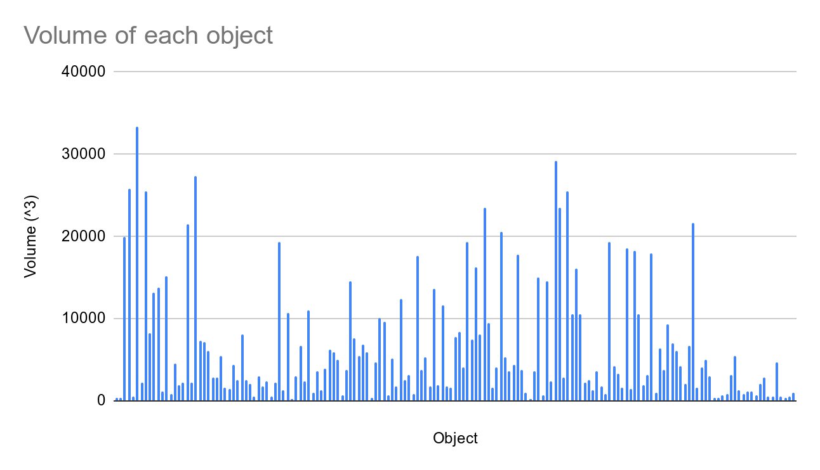
Graphs
All Objects

Slide 16
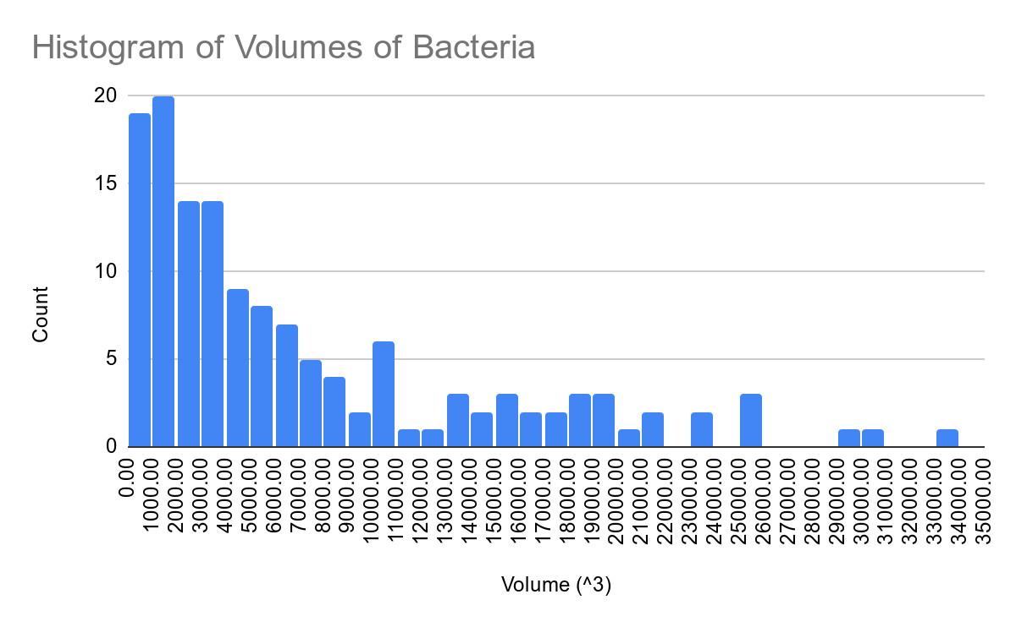
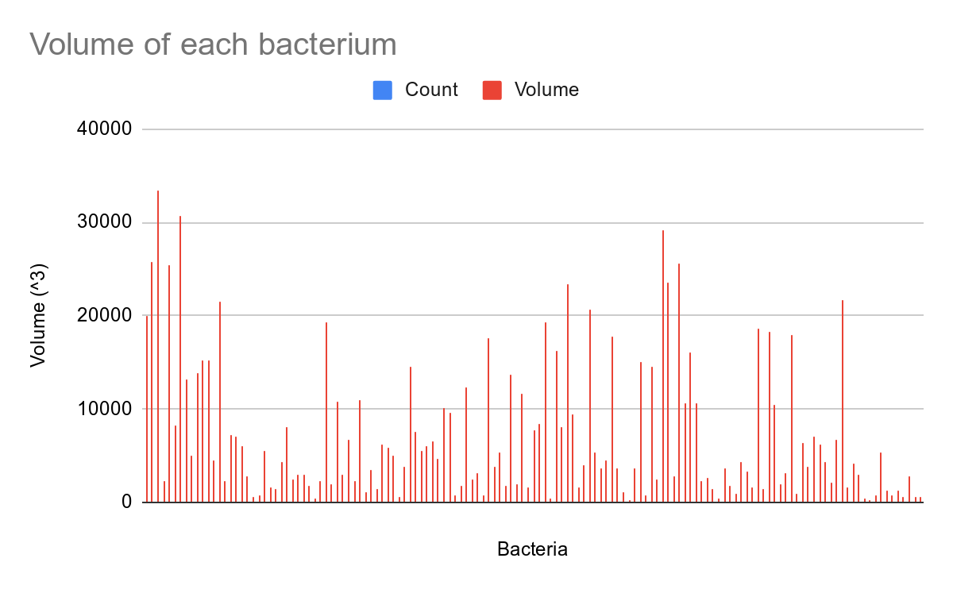
Graphs
Bacteria
Can hover over bars for details
Can change bin size

Slide 17
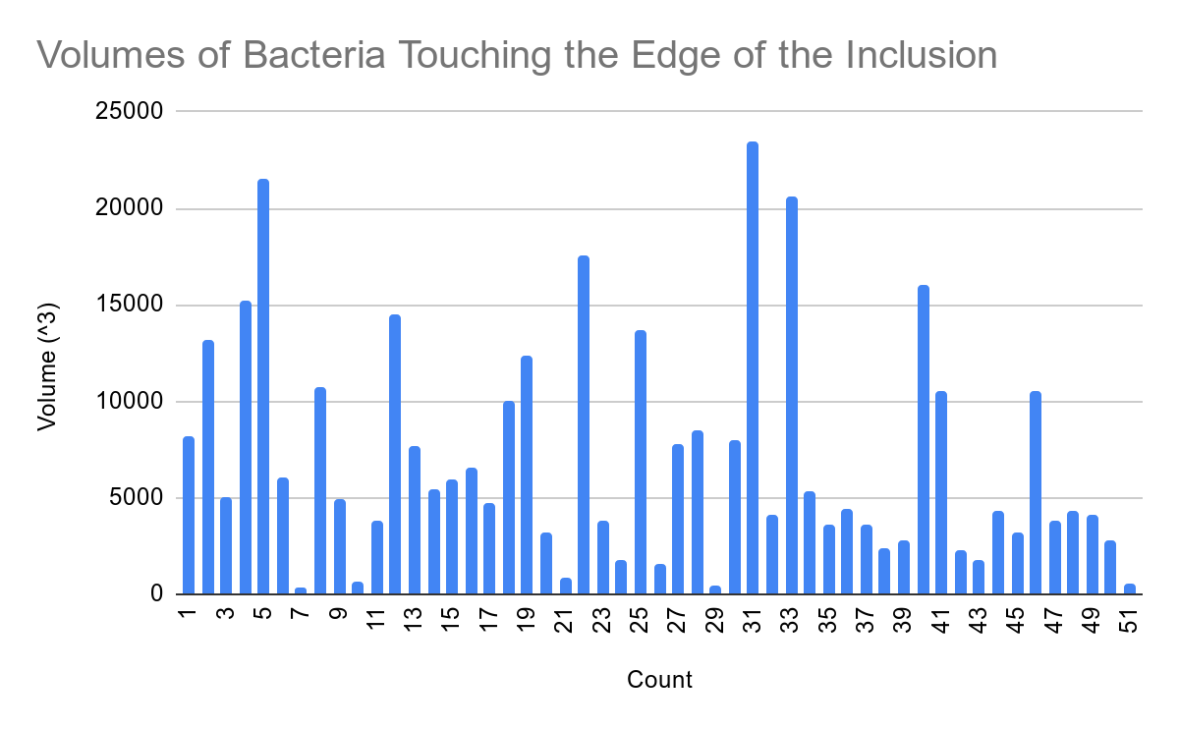
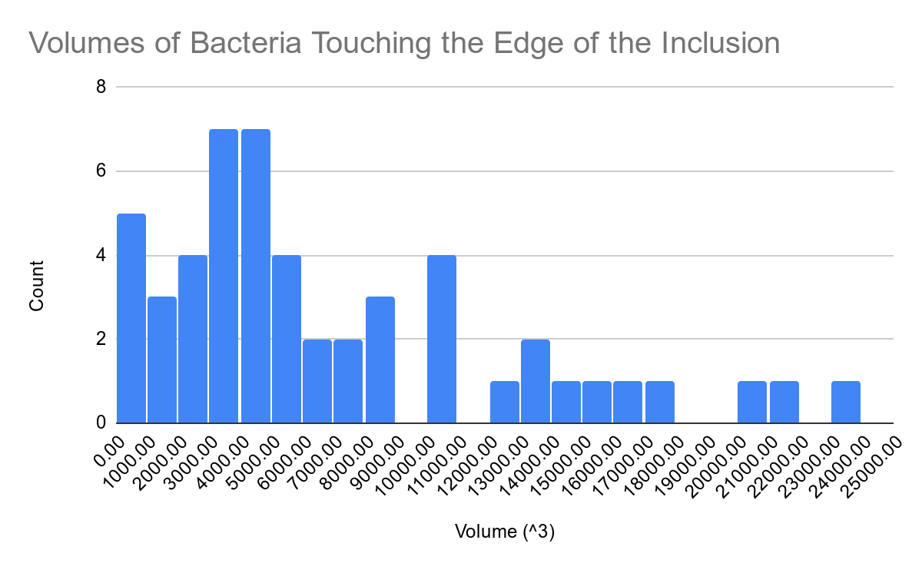
Graphs
Bacteria touching the edge of the inclusion
Can hover over bars for details
Can Change Bin size

Slide 18
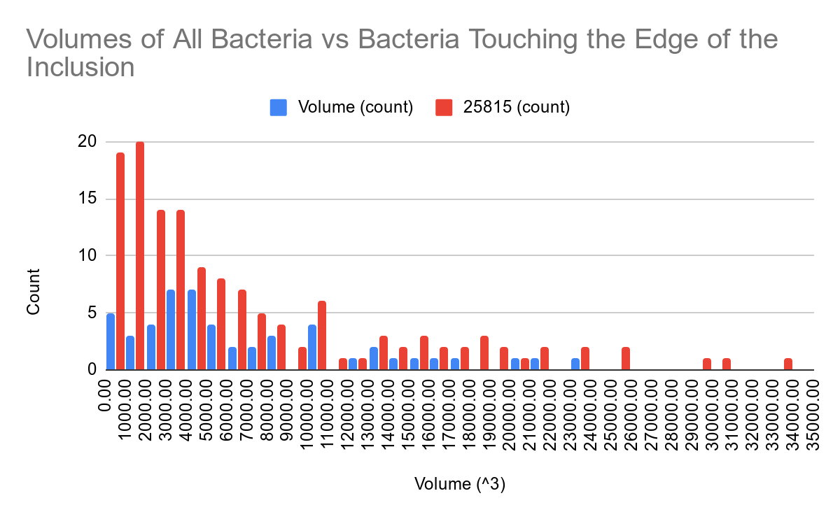
Graphs
Total Bacteria vs bacteria touching the edge of the inclusion
Bacteria touching the edge of the inclusion
Total Bacteria

Slide 19
Propose:
Questions:
EBs: up to 3000 pixels^3, mostly in the centre
2 populations of RBs: in centre and on edge
Dividing RBs: 3000-6000 pixels^3
What are the huge objects?
Up to 35000 pixels^3
In the centre (not touching edge of the inclusion)
It is a bacterium on the original tomogram, is it dividing?
(Look at coordinates of object on Fourier Transform and is not in the missing wedge)
(It is not touching the top or bottom as any objects touching the ends are discounted by the macro or when curating the data)

Slide 20
Current work:
Macro
Added customisable size filter for the 3D Objects Counter into the parameters that can be chosen at the start
Alter which steps are affected by the customisable parameters
Apply pipeline to other tomograms
Find the different parameters that give the best segmentation of each tomogram
Tune pipeline as errors arise and best method is found for each step

